Slide 1
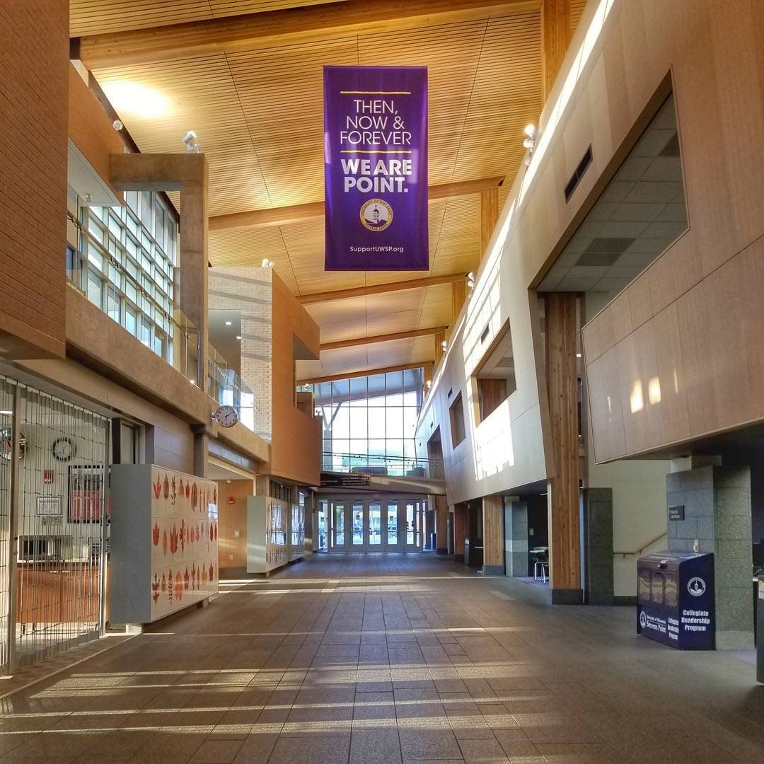
Managing Student Employment with Student Employees
Dani Allen, University Centers Student Employment Coordinator
Missy Burgess, PhD, Director of University Centers
UW-Stevens Point

Slide 2
Audience Introductions
New or experienced?
01
HR or a campus department?
02
Small team or a big team?
03
Supervise undergrads, grads, or both?
04
Notes:
Dani & Missy – introduce ourselves too.

Slide 3
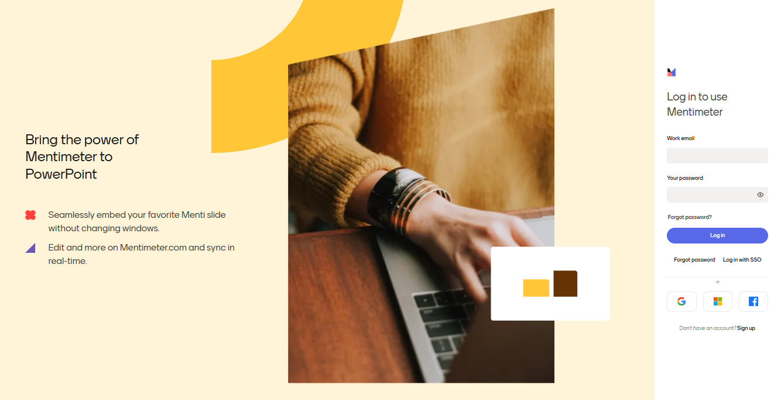
Mentimeter One – What do you hope to learn?
Notes:
Missy

Slide 4
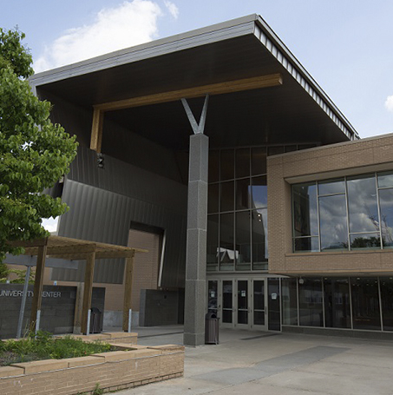
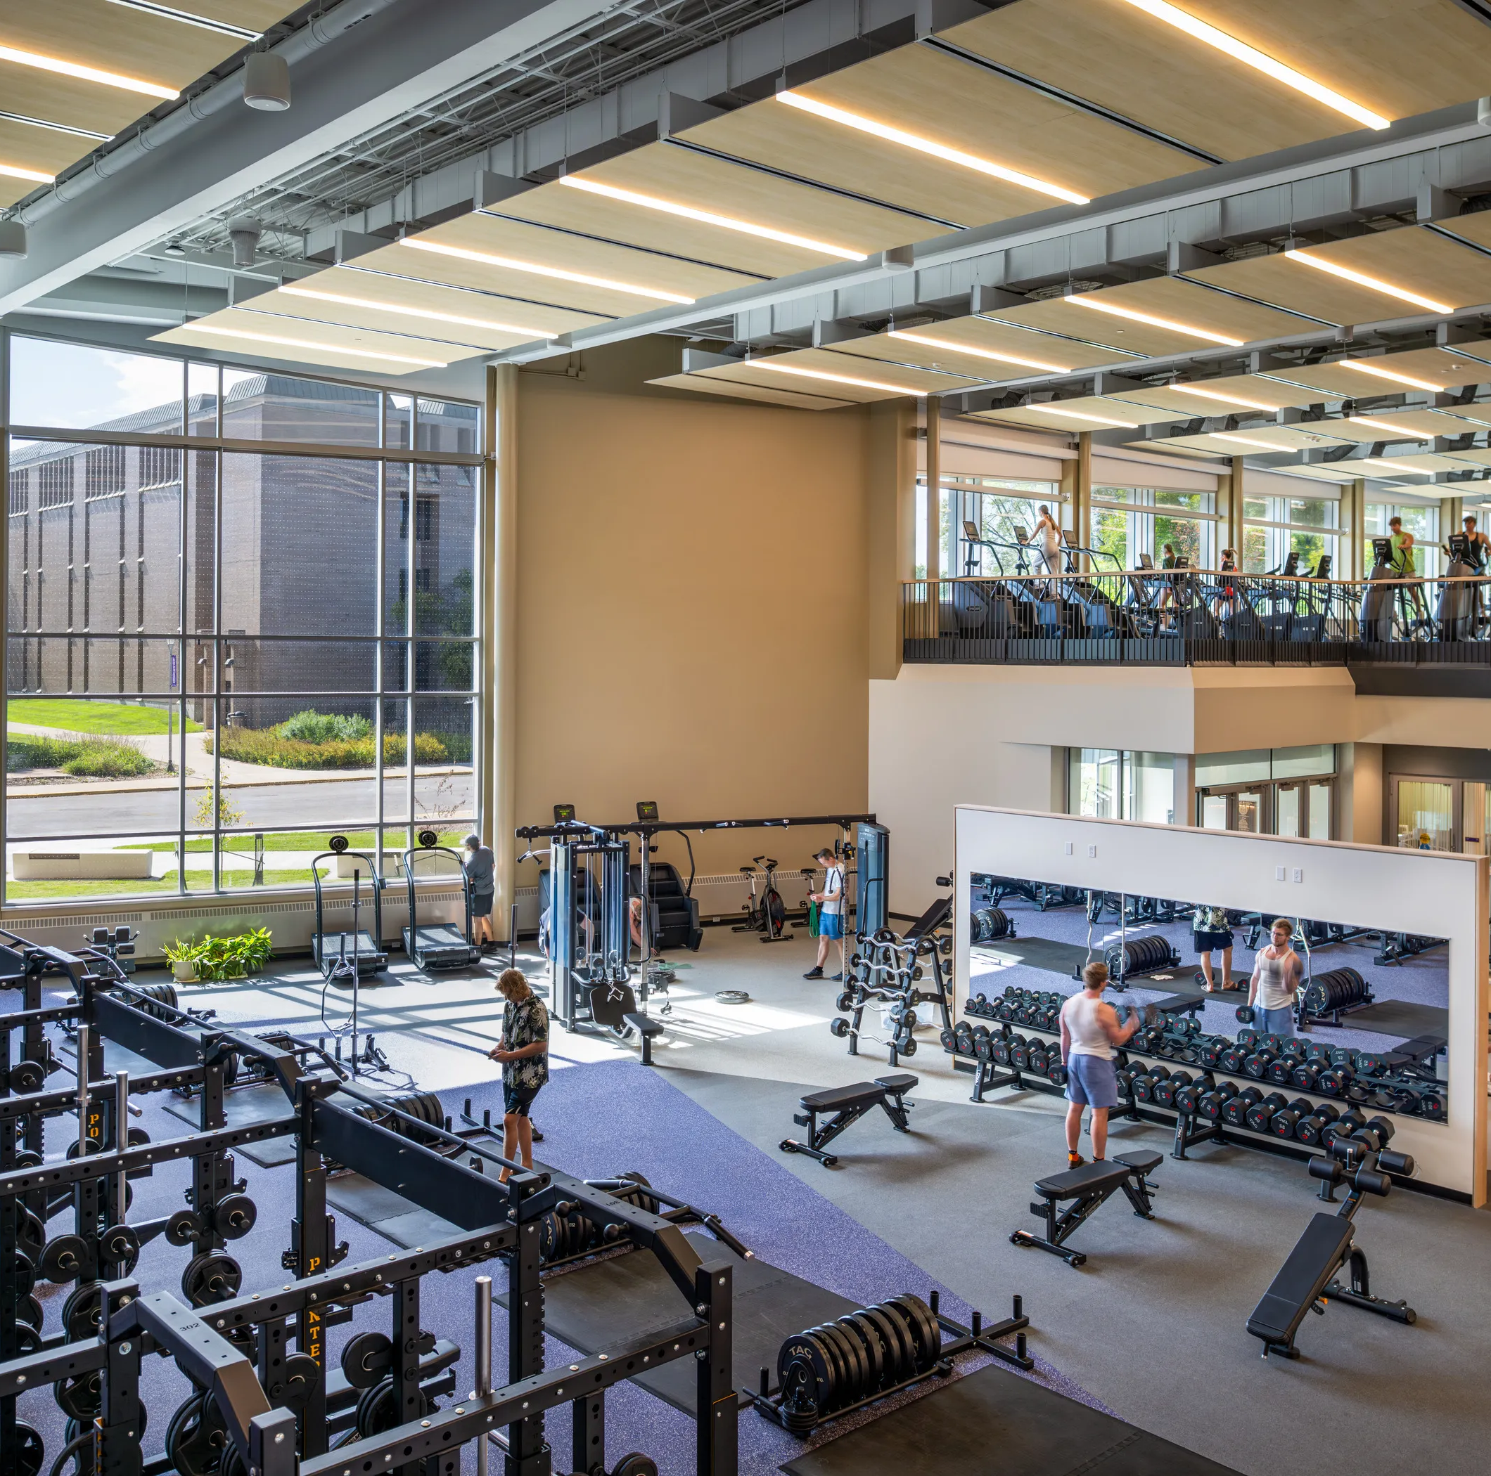
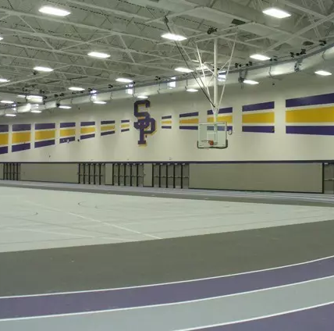
University Centers
3 buildings, 16 student-led teams
Dreyfus University Center (DUC)
UC Admin
UC Marketing
UC Operations
Centers Services Team
Event Technical Services
Campus Activities & Student Engagement (CASE)
Building Managers
CASE Programming
CASE Operations
Basement Brewhaus
University Information
& Tickets
UC Front Desk
Student Employment
Health & Wellness Center (HWC)
DAWG Fitness Desk
DAWG Fitness Floor
GroupEx
Marshfield Clinic Champions Hall (MCCH)
Intramurals
Activity Supervisors
Officials
Climbing Wall
Aquatics
Notes:
Dani

Slide 5
SuperStaff
Supervisory Staff (SuperStaff) includes all student managers (SMs), the Student Employment Coordinator (UCSEC), and Payroll Coordinator (UCPC).
SuperStaff attend a retreat/orientation before the start of each semester and then monthly meetings throughout the semester, in addition to any other meetings for their departments/teams.
Notes:
Dani

Slide 6
Tasks
Centralized Tasks
Hiring & Onboarding
Mandatory Training
Evaluations
Wage classifications
Paperwork
Grade requirements
Criminal Background Checks
UCSEC and UCPC carry out centralized tasks; some are done in office, others are reported by SMs or students.
Department-specific tasks are carried out by the SMs.
Notes:
Missy

Slide 7
Shared Tasks
Hiring
SMs handle selection.
Scheduling
Training
On-the-job training is managed by SMs.
SMs generally handle all time approval and tracking.
UCPC has the power to check timesheets for troubleshooting/back-up coverage.
UCSEC/UCPC take care of the Workday/HR half. Onboarding is done via appointment.
UCSEC assigns and monitors CPR, PCI, FET, Concussion Protocol, the 3 METs.
Notes:
Missy

Slide 8
Student Managers
Managers work directly with their student teams and with professional staff (ProStaff) for their departments.
Their duties include:
Selection
Interviewing candidates for positions in their departments and choosing who to advance.
Training
Providing on-the-job and online guidance to student staff; coordinating staff meetings and training.
Scheduling
Creating weekly schedules and coordinating special event assistance (CST/ETS/CASE); covering unclaimed shifts; approving timesheets biweekly.
Evaluation
Coordinating one-on-one time with each student staff member and rating their performance based on standardized competencies.
Communication
Monitoring student manager inboxes; keeping standard office hours; maintaining and providing accurate student staff records to ProStaff and UCSEC/UCPC.
Notes:
Dani

Slide 9
Quotes from SuperStaff
Sydney D. — DAWG Fitness Desk Student Manager
"I have been a student manager for Dawg Fitness/Allen Fitness Center for two years now. I have gained so many valuable experiences and skills during my time here and will eventually use them into my future career.
The University Centers leadership is very invested in supporting the student mangers they employee. My supervisor, Amy Fitschen, is dedicated to being an encouraging leader and helping me grow into a young professional. I have gained experiences such as issuing discipline, leading meeting, and being involved in the hiring process.
I am very grateful for what I have learned over the years and for the amazing people I met along the way."
Notes:
Dani

Slide 10
Quotes from SuperStaff
Rory E. — Event Technical Services Student Manager
"I’ve had the pleasure of being student manager for Event Technical Services since May 2025, and I have loved every minute of it!
Being in a management position seemed like a scary idea, but when it really comes down to, the most important thing I’ve learned is that you can always rely on your team. My fulltime supervisor, Chris Wylie, and I have worked hard to make this department as awesome as it is!”
Notes:
Dani

Slide 11
UC Student Employment Team
Student Payroll Coordinator
Requests and monitors job postings on Workday;
Leads SuperStaff meetings and plans trainings.
Processes new hires — requests GPA checks, CBCs, assigns SPIN access and email groups;
Tracks training compliance in Workbooks;
Student Employment Coordinator
Creates and maintains the Workbooks;
Monitors payroll status/compliance and sends reminders;
Tracks wage increases (longevities/etc.);
Onboards new employees.
Sits on the University Centers Student Organization Policy Board through Student Government;
Processes terminations and position changes;
Notes:
Dani

Slide 12
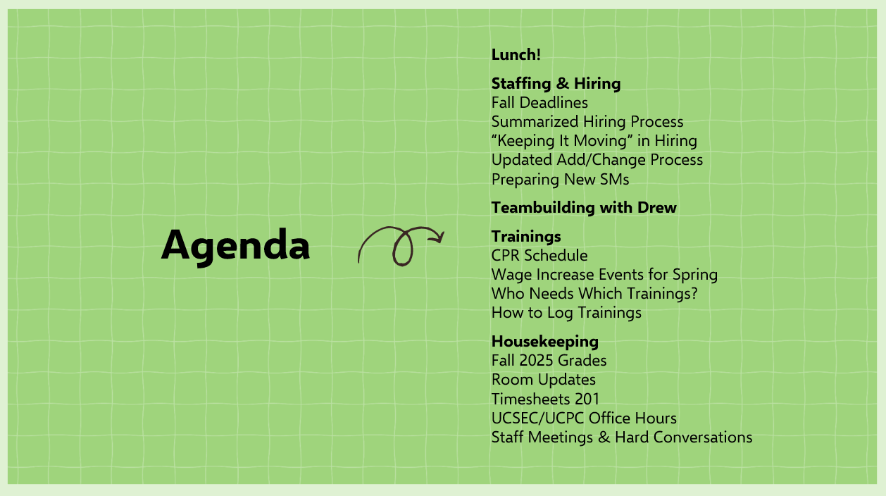
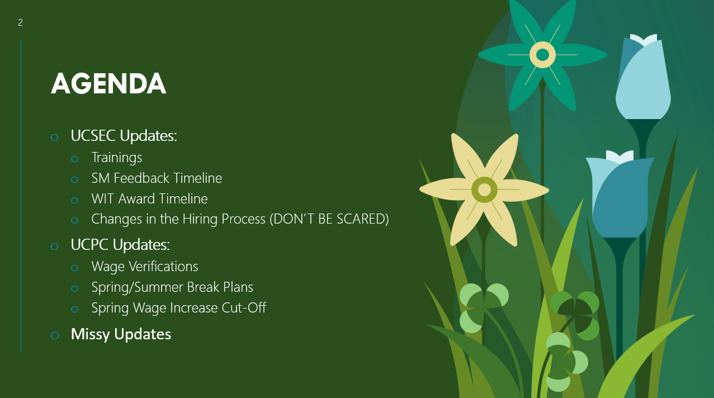
Sample
SuperStaff
Agendas
SuperStaff Orientations are lengthier and cover professional development in addition to admin resources.
Notes:
Dani

Slide 13
What’s Working Well?
SuperStaff
Student Staff
We have high student staff retention.
We build confident and independent student leadership.
Teams have high compliance with trainings and I-9s.
ProStaff can focus on other tasks —
they aren’t doing it all!
We recruit all kinds of students from campus, including athletes and majors from each college.
Our teams are full of high achievers!
Notes:
Missy

Slide 14
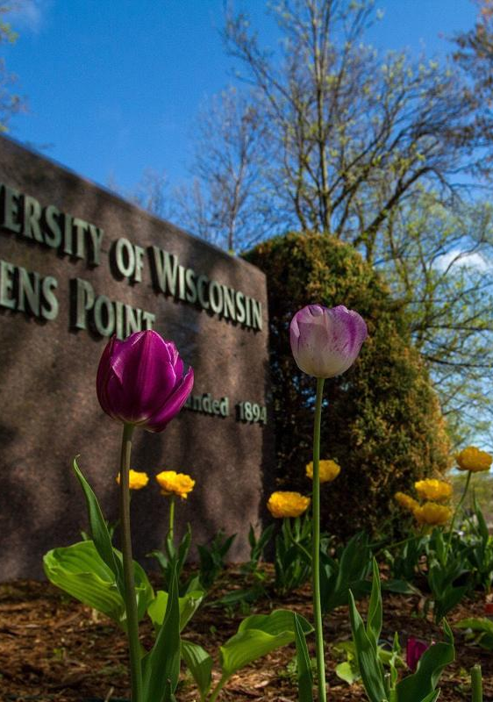
Spring GPAs
230 Total Positions
Average GPA 3.39
42 Positions got a 4.0
91 Positions on the Dean's List (greater than a 3.75)
10 Positions did not meet the minimum standard; 3 of those had already decided not to return
Highest Team GPAs: Group Ex (3.75), Marketing (3.61), and University Information & Tickets (3.60)
Notes:
Missy

Slide 15
Where Do We Struggle?
Posting & Selection
Processing
Position Start
Workday/HR Transition
There are lots of moving parts and pieces.
Sometimes people get STUCK.
Notes:
Missy

Slide 16
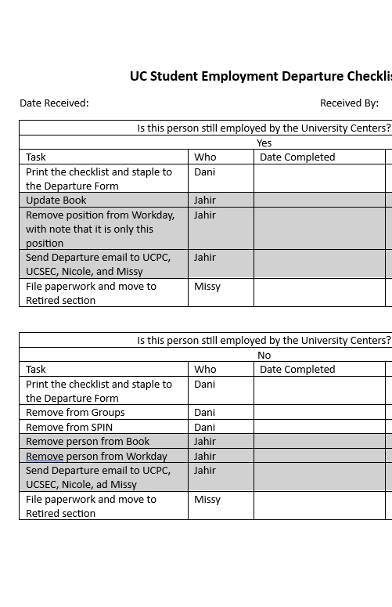
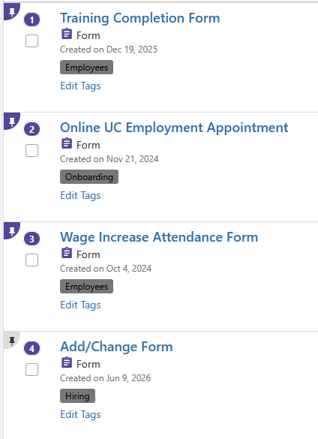
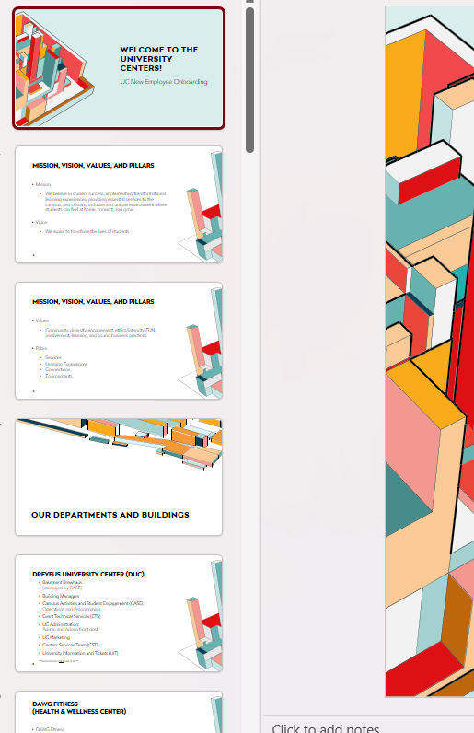
Tools That Help:
Administration
Checklists for hiring/departing/changing positions.
Workbook that tracks start dates, trainings, wages, and more.
SPIN forms for scheduling meetings and submitting paperwork.
Virtual Payroll/New Employee Orientation appointments.
Regular meetings with HR.
SuperStaff meetings are also VERY helpful for keeping student leadership up to date on our practices, especially during the system transition!
Notes:
Dani

Slide 17
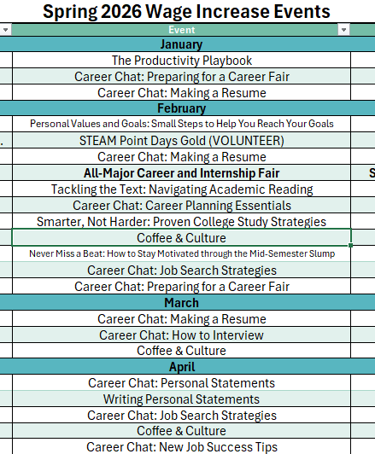
Tools That Help:
Student Retention
Wage Increase Events
Semesterly Longevity Wage Increases
RECOGNITION!
  Stoles for graduation
  Whatever It Takes Award
  High Five Award
Stoles are awarded to student staff who have worked at least 4 semesters and are graduating in good standing.
Notes:
Dani

Slide 18
The Summer To-Do List
Updating Position Binders- lots of things have changed!
Cleaning up paper and electronic files
Working to make more paper processes electronic
Setting up the fall Workbook
Workday Clean Up- is everyone on our team still working for us in the fall?
Longevity Wage Increases
Fall Hiring
Planning SuperStaff Training
Fall Early Arrivals
Other Duties as Assigned :)
Notes:
Missy

Slide 19
Mentimeter Two – What did you learn?
Notes:
Missy

Slide 20
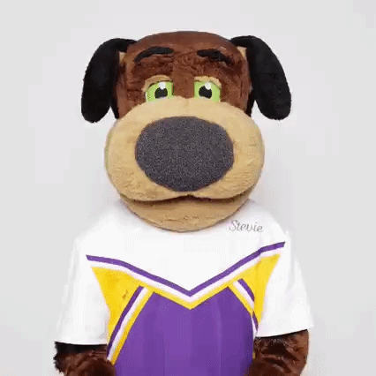
Any Questions?
Thank you!
Notes:
Dani & Missy

