Slide 1

Welcome!

Slide 2
Question will be read
1.
The Rules.
Contestants will have 20 seconds to write their answer on the whiteboard
2.
Always: 4 Contestants at a time
Closest answer without going over, wins a prize!
3.
Audience Participation Encouraged
Notes:
Kari

Slide 3

FIRST CONTESTANTS
Notes:
Kari

Slide 4

What is the highest amount of applications received for a single job?
**Through the Student Jobs Website (PageUp) in FY25**
Notes:
Kari

Slide 5
What is the highest amount of applications received for a single job?
Correct Answer: 380
Notes:
Kari

Slide 6
Student Employment Snapshot
FWS students
2,219
Student Employees
Student applications
13,815
37,390
Notes:
Kristina

Slide 7
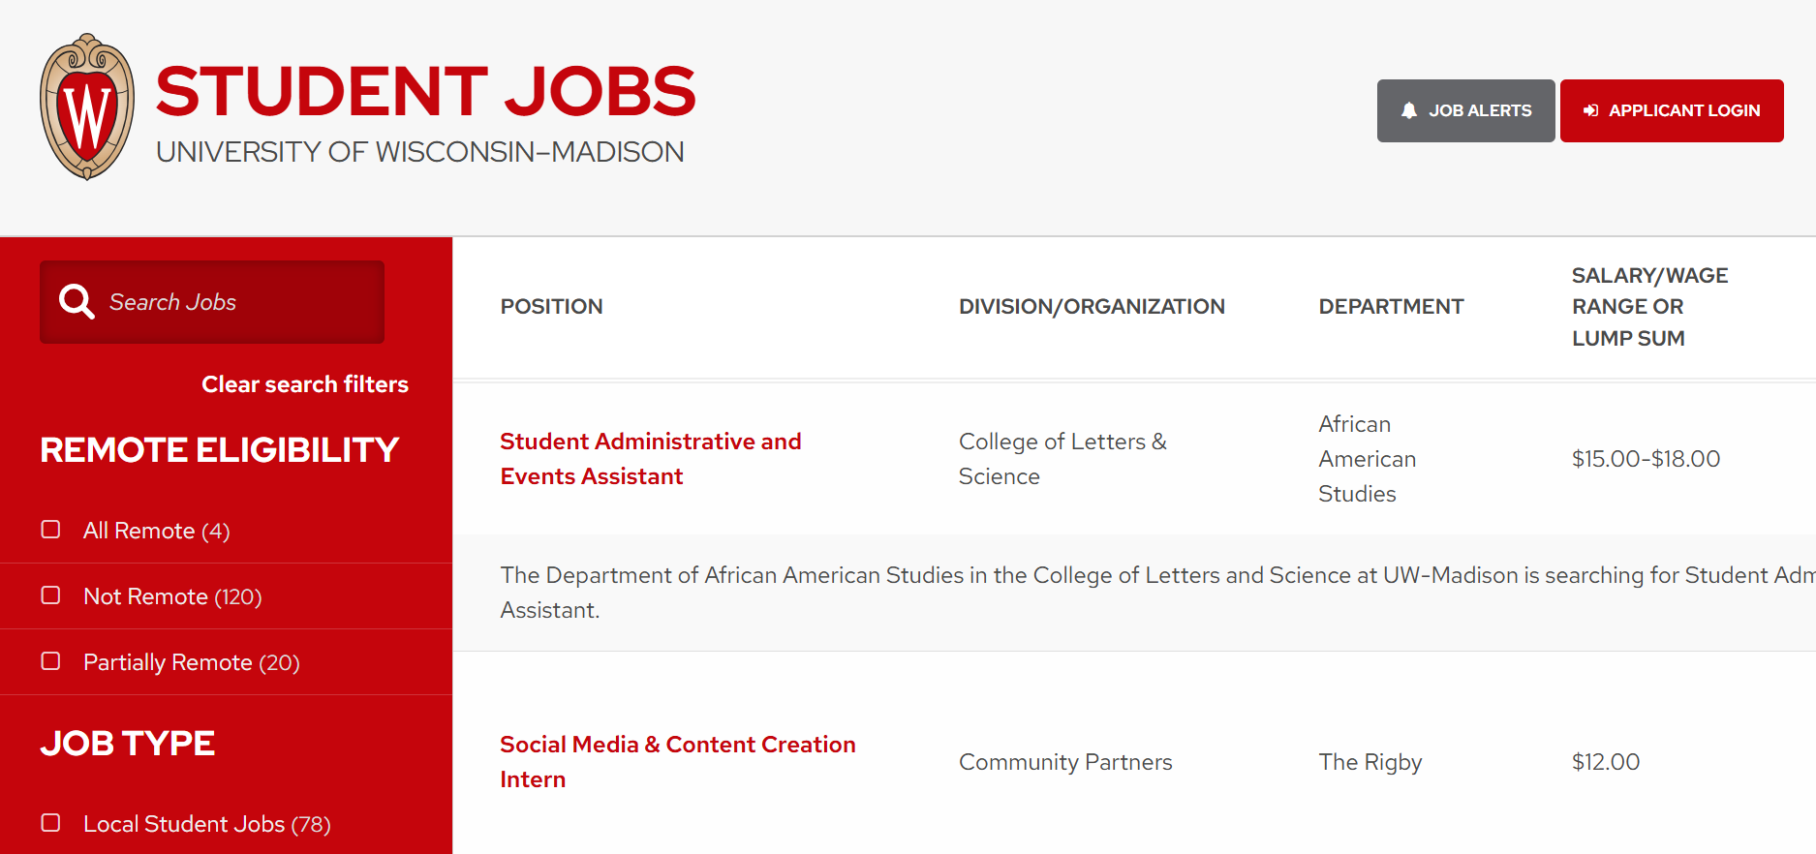
Student Jobs Website
On campus jobs
Off campus jobs
Federal Work Study eligible roles
Notes:
Kristina

Slide 8
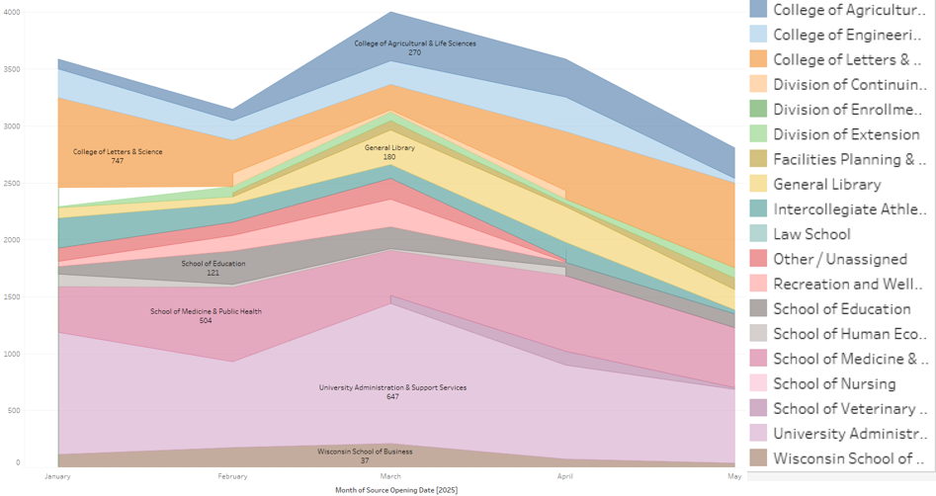
Student Jobs Website:
When Employers Post
Peak Season
August to September
Notes:
Kristina

Slide 9


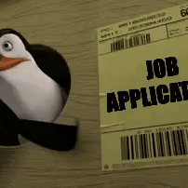
Average Applications:
Max applications
Roles with 100+ applications
36
380
33
Notes:
Kristina

Slide 10
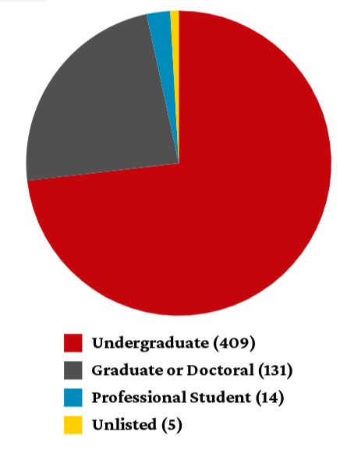
Student Employment Engagement Survey
Annual Survey sent to All Students
2026: 923 student responses
74% of respondents working (on or off campus)
35% were first year undergraduate students
58% were Wisconsin residents
59% worked one job and 29% worked 2 jobs
Notes:
Kristina

Slide 11
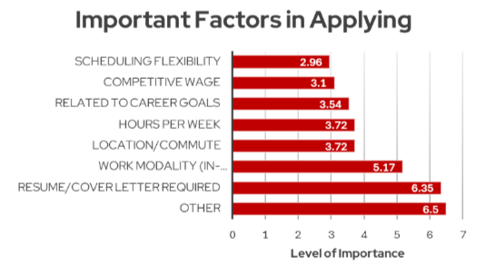
Factors in Applying
01.
Scheduling Flexibility
02.
Competitive wage
03.
Related to career goals
Notes:
Kristina

Slide 12
Students decide not to work while enrolled. Curious why? So are we.
A.
B.
C.
81% of students put academics first.
50% noted that tuition and expenses were covered.
35% were prioritizing extracurricular activities
Notes:
Kristina

Slide 13
And now a word from our Sponsors
Notes:
Kari

Slide 14
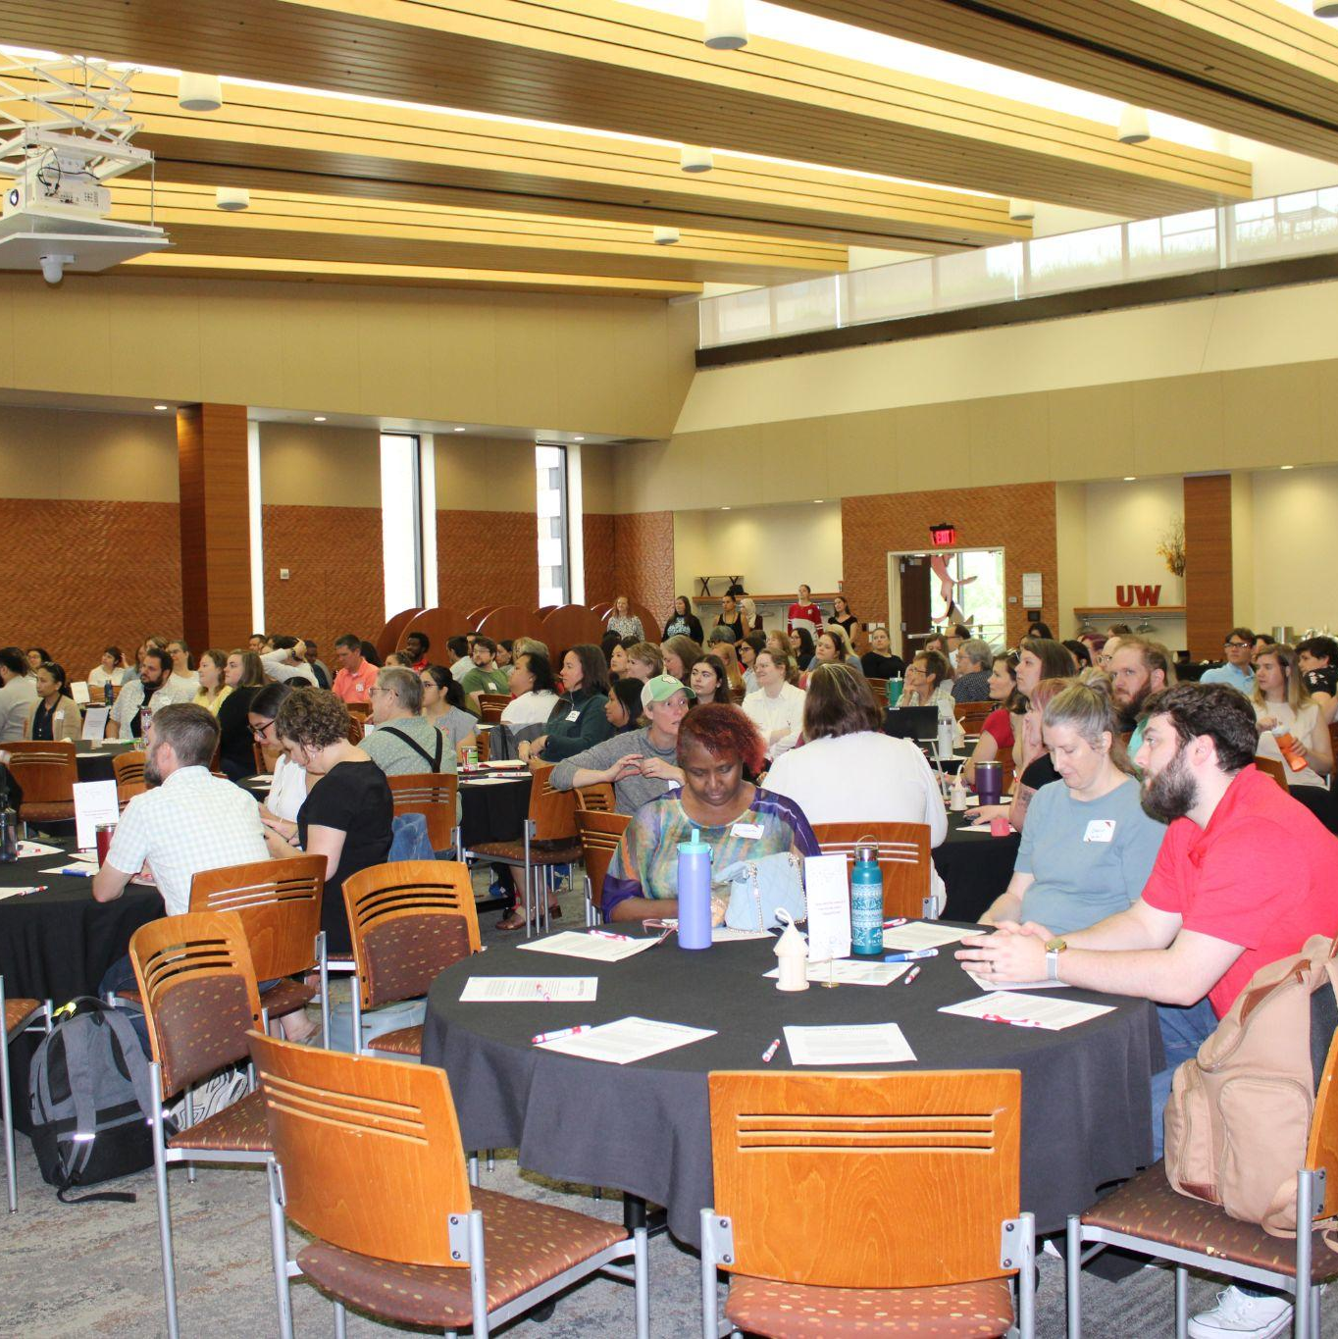
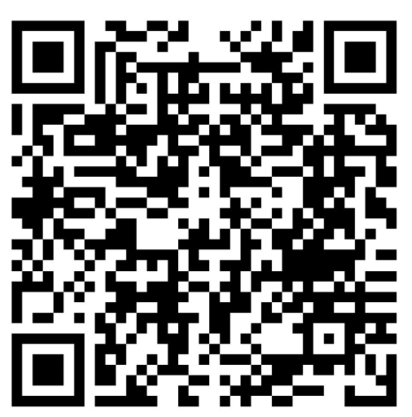
Student Supervisor Community of Practice
More than a meeting. More than a discussion. A gathering of ideas, strategies, and expertise from across campus.
Notes:
Kristina

Slide 15
What is the current average hourly wage for student employees at UW-Madison?
Notes:
Kari

Slide 16
What is the current average hourly wage for student employees at UW-Madison?
Correct Answer: $16.01
Notes:
Kari

Slide 17
Pay expectations
Undergraduate Average | Graduate/Professional Average
$16.54 | $22.01
When asking what a competitive pay would be:
23.3% of undergraduates selected $12-15.99; followed by $17-17.99 selected by 22.5%
39.5% of graduate/professional students selected $20-25; followed by $16-19 selected by 25%
Notes:
Kasie

Slide 18
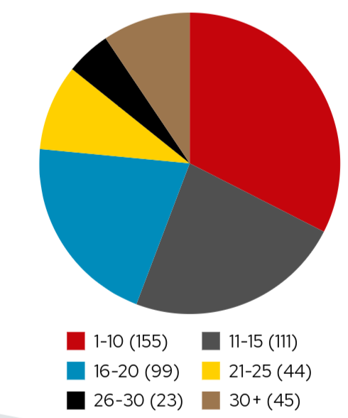
Student Employment Engagement Survey
Student respondents average weekly hours
15.8 Hours Per Week
32%: 1-10 hours
23%: 11-15 hours
20%: 16-20 hours
Notes:
Kasie

Slide 19
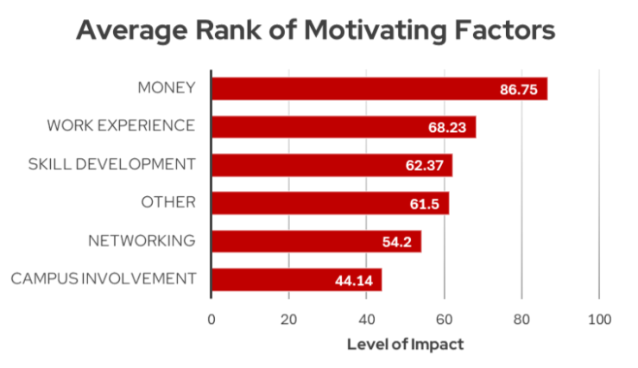
Motivators
01.
Money
02.
Work Experience
03.
Skill Development
Notes:
Kasie

Slide 20
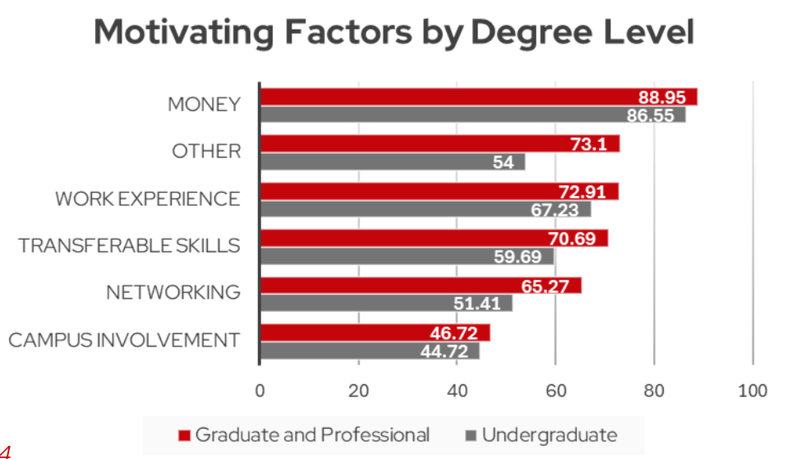
Graduate/Professional Student
Notes:
Kasie

Slide 21
And now a word from our Sponsors
Notes:
Kari

Slide 22
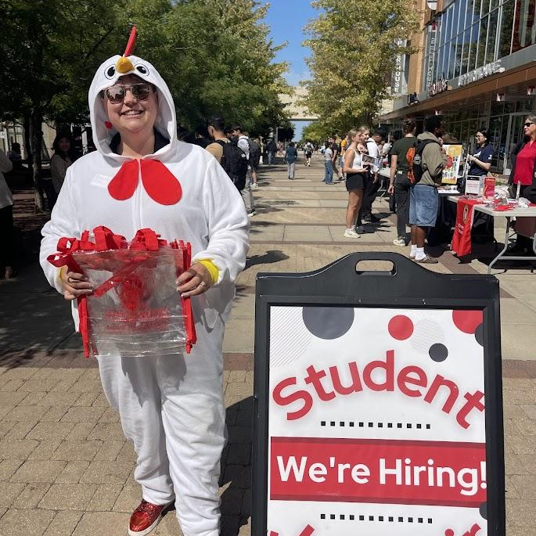
Student Employee Job Fair
September
More Details to come
Recruit Students at the Event!
Notes:
Kristina / Kasie

Slide 23
How much was the 2025-2026 UW-Madison Work Study federal funding amount?

Slide 24
How much was the 2025-2026 UW-Madison Work Study federal funding amount?
Correct Answer: ~$2,071,000

Slide 25
Federal Work Study
5,747 students awarded Federal Work study in 2025-2026
2,219 Students earned Federal work study across 2,870 roles

Slide 26
What is Federal Work Study?
Federally Funded Need based part time employment program
Payroll costs are shared by the federal government and employer
Federal Work-Study is the portion of your Financial Aid offer set aside for you to earn at a job
Work study funds are received through a paycheck as you work; they are NOT applied directly to tuition
Work study can be earned at any on campus student hourly position
Notes:
Federal Work Study
Hours credited due to a Federal Work Study program do not count toward the calculation of hours of service earned for purposes of the ACA.
Work-study is not a grant or a loan but a need-based, part-time employment program in which the government and the employer share the payroll cost of employing you.
Unlike grants, loans, and scholarships, the dollar amount you’re awarded in work-study will NOT apply directly toward tuition nor will it be disbursed to you directly in a lump sum. Instead, you earn the offered amount through working at your Student Job. Federal Work-Study is the portion of your Financial Aid offer set aside for you to earn at a job. Federal Work-Study must be earned at eligible Student Jobs.

Slide 27
Policy Note: Total Hours
A student hourly employee must average below 30 hours per week. (It is acceptable in a single pay period for a student hourly employee to work more hours one week and fewer hours the next, as long as the overall average is below 30 hours per week.)
While a student hourly employee is eligible to work more than 40 hours per week and receive premium pay, all hours worked (including hours over 40) count toward the calculation of total hours for purposes of the Affordable Care Act (ACA) and must be monitored by the schools, colleges, and/or divisions. If an employee works for multiple schools, colleges, or divisions at the university or at another UW System institution, all hours worked/reported must be combined and stay below the 30-hour weekly average.
Notes:
Federal Work Study
Hours credited due to a Federal Work Study program do not count toward the calculation of hours of service earned for purposes of the ACA.

Slide 28
Policy Note: Student Breaks
Employees working more than four hours but less than six consecutive hours in a single shift are expected to take a 15-minute paid break each shift.
Employees working more than six consecutive hours in a single shift must take a minimum of a 30-minute unpaid lunch during their shift, in addition to two 15-minute paid breaks each shift.
Lunches and breaks may not be combined to create a longer break or to modify an employee’s start or end shift times.
Modification of lunch and break provisions may only occur through written work unit policy, or with approval from the employee's supervisor.

Slide 29
And now a word from our Sponsors
Notes:
Kari

Slide 30
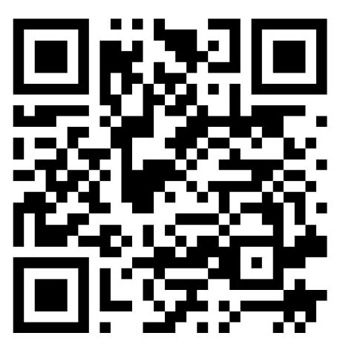

Basic Needs Support
Food
Health
Clothing
Child & Family Care
And more…
One call, that’s all
Notes:
Kasie

Slide 31
How many jobs were posted to the Student Jobs website between August 2025 - May 2026 ?
Notes:
Kari

Slide 32
How many jobs were posted to the Student Jobs website between August 2025 - May 2026 ?
Correct Answer: 907
Notes:
Kari

Slide 33
Student Job Challenges
Lack of employer communication
Job description requirements and criteria
Application process and materials
Scheduling concerns
Notes:
Kasie

Slide 34
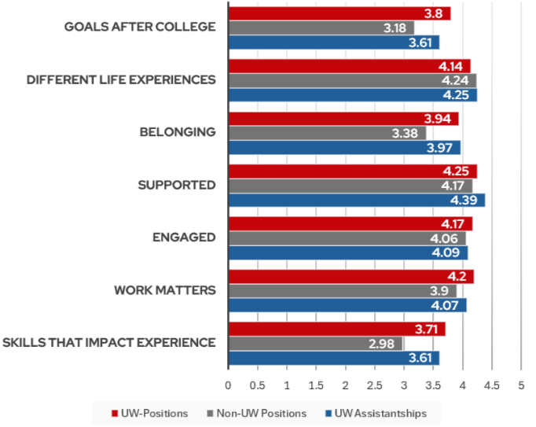
Student
Employment
Environment
01.
Goals after college
02.
Belonging
03.
Skills that impact experience
Notes:
Kasie

Slide 35

WiGrow
WiGROW is an engagement initiative designed to support the learning of student employees. Supervisors and student employees engage in intentional, reflective conversations each semester, providing the opportunity for connections between on-campus employment, career goals, and the college experience to flourish.

Slide 36
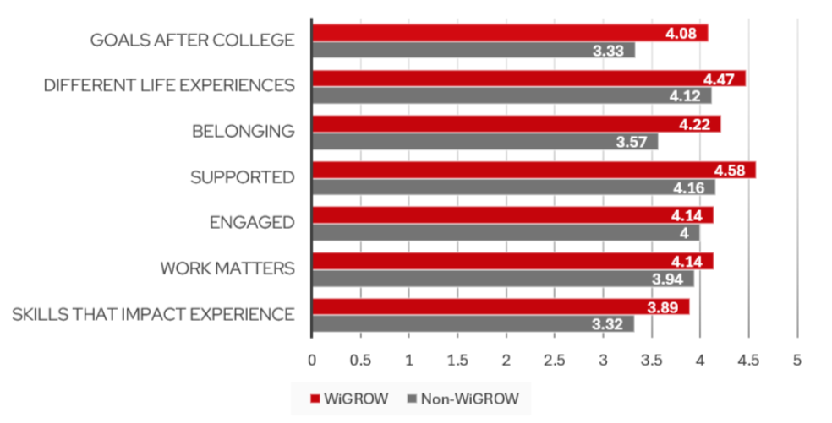
WiGrow

Slide 37
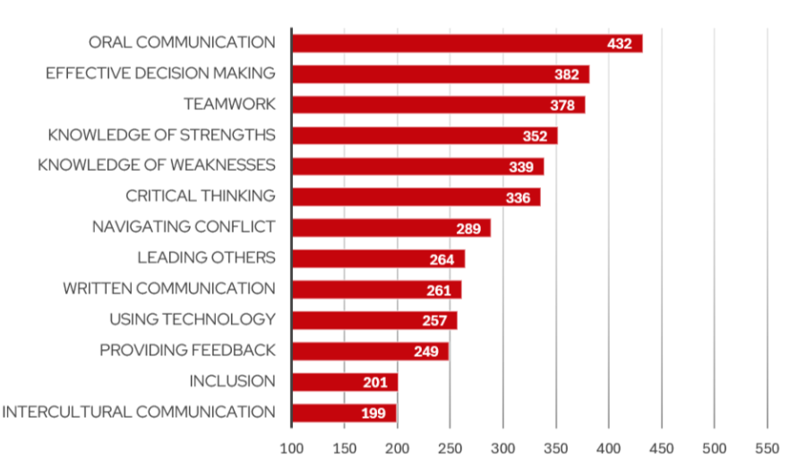
Skills gained In Workplace
01.
Oral communication
Effective decision making
02.
03.
Teamwork
Notes:
Kasie

Slide 38
And now a word from our Sponsors
Notes:
Kari

Slide 39
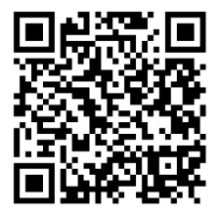

Student Employee Appreciation
Celebrate with campus the second full week of April! Departments across campus team up to provide a range of free, on-campus events throughout the week to recognize the hard work and dedication of our student employees all year long.
Notes:
Kristina

Slide 40
Showcase Showdown

Slide 41
How many supervisors completed the first Student Supervisor Certificate program?

Slide 42
How many supervisors completed the first Student Supervisor Certificate program?
Correct Answer: 33

Slide 43
And now a word from our Sponsors
Notes:
Kari

Slide 44

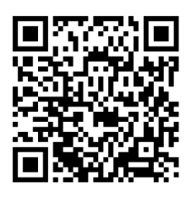
Student Supervisor Certificate
The Student Supervisor Certificate has been implemented at UW to center practice, development, encouragement, support, and accessibility. In order to complete the program, pro-staff must complete eight required classes, six in-person and two virtual offerings, focused on High Impact Practices, the Dimensions of Wellness, recruitment and onboarding, technology, and much more!
Notes:
Kasie
Kristina/Kari - Sidekicks

Slide 45
Thanks for joining today

