Slide 1
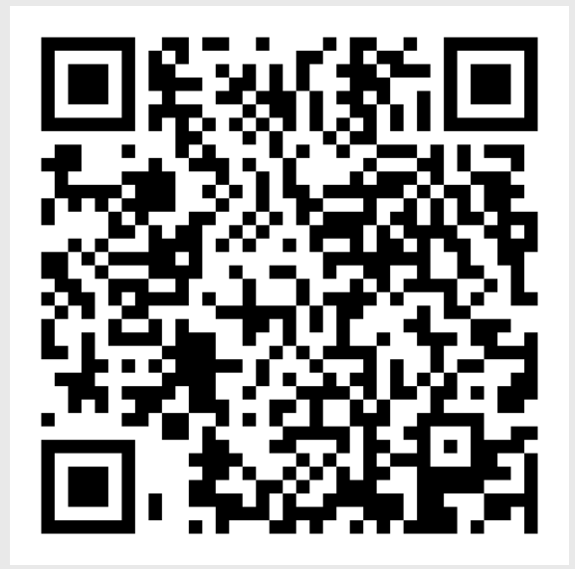
Student Employee Accommodations
Gwynette Hall (she/her)
Assistant Director, Adaptive Technology

Slide 2
Acknowledgements
Do what you need to make this the most meaningful experience for you.
Move, sit, stand, hydrate, take a break
Auto caption via PowerPoint will be turned on
Ask questions as we go
Let me know if you are experiencing any access barriers

Slide 3
Supervisors with Positive Impact
Practice three things:
Attitude is almost everything
Practice a little grace, kindness, and patience
Be open to alternative perspectives

Slide 4
Accommodations on Campus
Student
Employment
Classroom accommodations
Work with the McBurney Disability Resource Center
Work accommodations
Work with Divisional Disability Representative (DDR) and Employee Disability Resources (EDR)

Slide 5
Laws and Policies
Americans with Disability Act (ADA)
Section 504 of the Rehabilitation Act
Wisconsin Fair Employment Act (WFEA)
Regent Policy 14-10
Family Medical Leave Act (FMLA)
Wisconsin Family Medical Leave Act (WFMLA)
Notes:
As a university, we are bound by laws and policy to ensure access to digital content.

Slide 6
Employee Accommodations Process
Request accommodations through Divisional Disability Representative (DDR)
Provide medical documentation
DDR works with employee, supervisor, and Employee Disability Resource Team to identify reasonable accommodation options

Slide 7
Providing Accommodations
Formal
Informal
Requested through DDR and EDR
Requires medical documentation
Can take time to put in place
Requested through supervisor
No medical documentation
Quickly implemented

Slide 8
Why Provide Informal Accommodations?
Signals support and welcome
Gives a sense of belonging
Safe and positive environment
Lessens the burden of responsibility for disabled employee
Reduces barriers and limitations in the environment for everyone

Slide 9
Inclusive Practices
Training
Executive Functioning
Community/Communication
Physical Space/Environment
Supervisor Meetings

Slide 10
Training
Be understanding and open, but clear about expectations​
Present content in different ways​
Provide reference documents that can be used without supervisor​
Give examples when explaining​
Create space for processing time
Set aside a time for practice and check-in on progress​
Practice interactions and role play​
Do not assume knowledge ​
Notes:
Hands-on, visual, auditory​
Be straight forward and get to the point; reduce steps as much as possible. ​
Create job manuals or 'how to' documents​
Schedule consistent check-ins on a schedule​
Talk through situations they may encounter or a situation they did encounter but need to improve on​

Slide 11
Executive Functioning
Send reminders for appointments, meeting, and events​
Create a calendar with task schedule and due dates
Consistent naming of tasks, folder structure, job titles
Ask how you can support next steps​
Give steps to accomplish goal/task in writing - remember that not all steps or structures are intuitive
Create daily tasks lists or check lists

Slide 12
Community
Continue open communication about accommodations
Give option for visual disclosure of pronouns ​
Provide and wear name tags
Consider colloquial language and do not assume you are understood​
Create and explaining community agreements​
Be thoughtful of personal space​
Meet people where they are at​, not everyone has the same experiences
Avoid absolutes
Create accessible Word, PDF and PPT documents ​
Notes:
Let employees know that you can and will honor accommodation requests during entire process of application through employment. Share more at end of presentation​
Share your pronouns when introducing and include in signature​
Not everyone uses and knows the same colloquial sayings. People will pretend to know, because they think they should.​
Set group norms​
Sending a quick hi or check-in, builds community​
Ex: Do not offer to shake hands, let the employee take the lead​
Not everybody has 2 parents, goes home for holidays or breaks, enjoys football games,​
Let the employee know that if they already know something they can let you know, so you can skip that information.​

Slide 13
Physical Space/Environments
Have fidgets available​
Have alternative lighting options
Provide a variety of seating and desk options
Room to move and navigate​
Provide options for movement breaks
Intuitive placement of supplies and document system
Tour space for locations of all exits, bathrooms, and water
Avoid wearing scents or adopt a fragrance-free policy
Avoid common allergens in office
Notes:
Lighting options: example: lamp so overhead light can be turned off) ​
Room to move and navigate: Clear the floor​
Common Allergen example: peanuts, label food if bring something to share​
Standing desk: have a shared one or rotating access​
Chairs: back support, cushioned vs hard, height can make a difference.​
Space: Point out accessible bathrooms, exits and entrance and Know and share locations of gender neutral and single stall bathrooms​
Consider time to bathrooms and accessible doors. Going up two floors for access will take more time than the ability to use what's available on the same floors​

Slide 14
Supervision Meetings
Provide agendas, discussed resources, or processes prior to meeting​
Invite self-advocacy so individuals can share what is working or not working for them interpersonally​
Offer variety of ways for people to provide feedback ​
Read aloud any materials you review or go over
Clearly indicate next steps or tasks
Provide a shared document to track meeting notes

Slide 15
Resources
UW-Madison Employee Rights and Responsibilities
Employee Disability Resources (EDR)
Divisional Disability Representatives (DDR)
McBurney Disability Resource Center
Notes:
Katy

Slide 16
Questions/Discussion?
What are some of the ways you have provided informal accommodations?
What have been some of your experiences with formal accommodations?
What questions do you have for the group about employee accommodations?
Contact Gwynette Hall directly at Gwynette.Hall@wisc.edu
Notes:
Katy

